Slide 1
Basic Spotfire Introduction
Mike Benzy / Sr. Analyst-Claims Prevention / NA District
Little Rock, AR October 16 – October 18, 2017

Slide 2


Class Goals For Everyone In Attendance:
Leave with the ability to successfully navigate a Spotfire report (and show others how to do it too!)
Obtain a working knowledge of how to create and modify a dashboard that conveys a visual message appropriate to the audience
Know where & how to access help when you get stuck
“My Fellow Americans:
Ask not what your data is telling you, ask what you can make it say with Spotfire!”
John F. Kennedy / Inaugural Address
Learn To create
Get your creations to interact
Make it say what you want it to say

Slide 3
Itinerary - Day 1
Local messages / Team Introductions
Spotfire Introduction – What is it? What can Spotfire do for you?
Introduction to the dashboard & visualization flow
Basic navigation through a completed report from SPS (or local backup)
I have data – Now what?
Adding multiple pages / Page Navigation
Home Screen Options
What do all the icons mean?
LUNCH – 12:00pm
Follow along with the instructors
Create Bar Chart (Colors Introduction)
Create Line Chart
Create Combination Chart
Create Pie Chart
Create Tree Map
Follow along with the instructors
Create Table
Create Summary Table
Create Cross Table
Create Text Area
Sharing Data Options
Dinner at a good restaurant, like Mendy’s
Helpful Tips:
To avoid having to take this class again…
Please take lots of notes!
Please ask questions if you feel lost
Please do not try to think ahead
Please BE HERE NOW

Slide 4

What Is Spotfire???
TIBCO Spotfire is a smart, secure, governed, enterprise-class analytics platform with built-in data wrangling that delivers AI-driven, visual, geo, and streaming analytics.
Spotfire allows you to more quickly visualize your data, and in ways that display more dimensions of data than your standard excel charts.
It allows you to ask and answer questions about data on the fly, without configuring pivots, formulas, ranges, olap cubes, indexes, keys, etc.

Slide 5
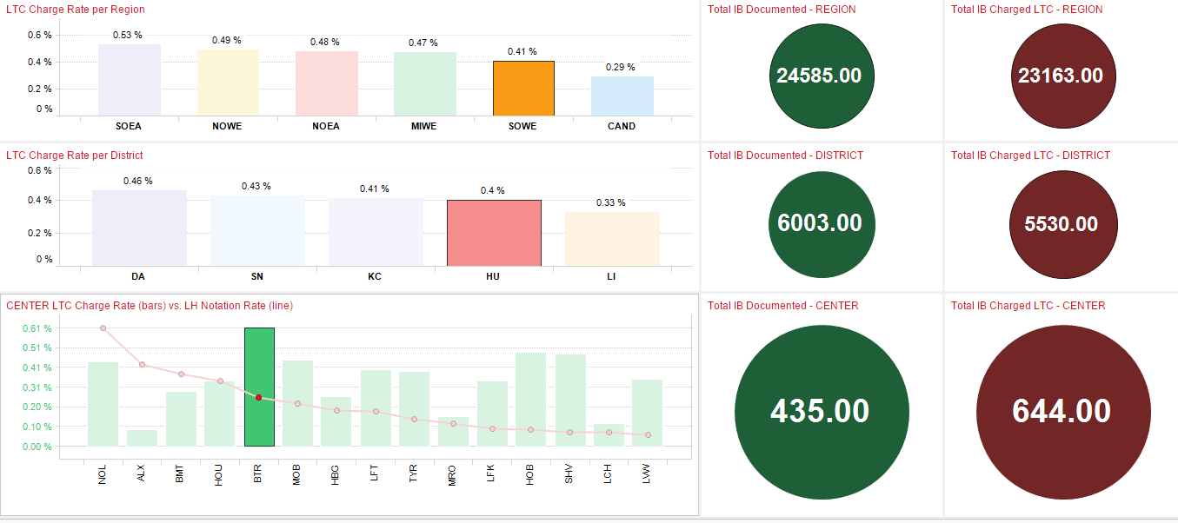
What Can Spotfire Do For You?
Create drill-down report visualizations that can be easily exported:

Slide 6
What Can Spotfire Do For You?
Spotfire can export report graph visualizations, eliminating the need for hundreds of lines of data:
Total LTC Charges by Shipper:

Slide 7
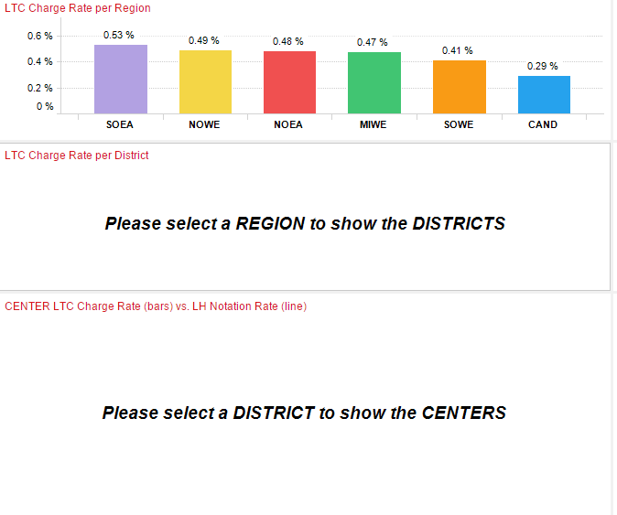
Introduction to the Dashboard & Visualization Flow (1):
Often times, a report will give you instructions how to get to the data you want to see.
In this example, we wish to see performance for an actual center, so we need to select an operating region to narrow the data to the district level.
One of the great benefits of Spotfire is the ease and ability to “drill down” and have the report create an immediate visualization of the drilldown results.

Slide 8
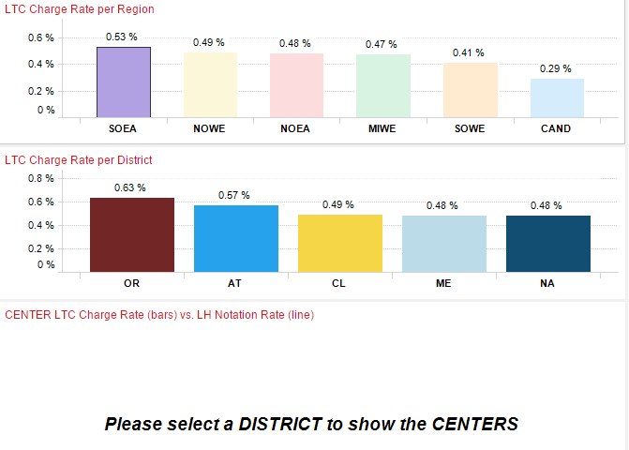
Introduction to the Dashboard & Visualization Flow (2):
When “SOEA” is selected, it narrows the data to show only districts within the SOEA.
From here, we can see how NA compares to all other districts, or go even further to see individual centers.
You can tell what was selected, because it is often highlighted.

Slide 9
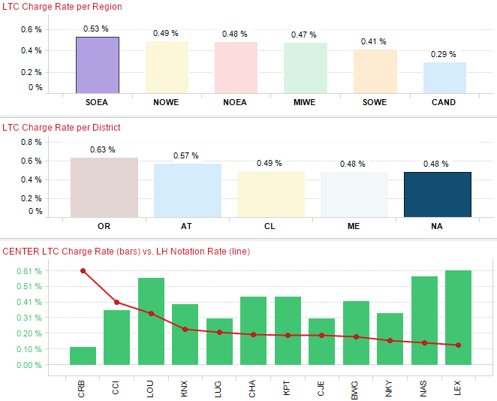
Introduction to the Dashboard & Visualization Flow (3):
When “NA” is clicked on, it narrows the data to show only centers within the SOEA.
From here, we can get details from an individual center, often narrowing down as detailed as you like in just a few clicks, compared to sorting & filtering through excel.

Slide 10
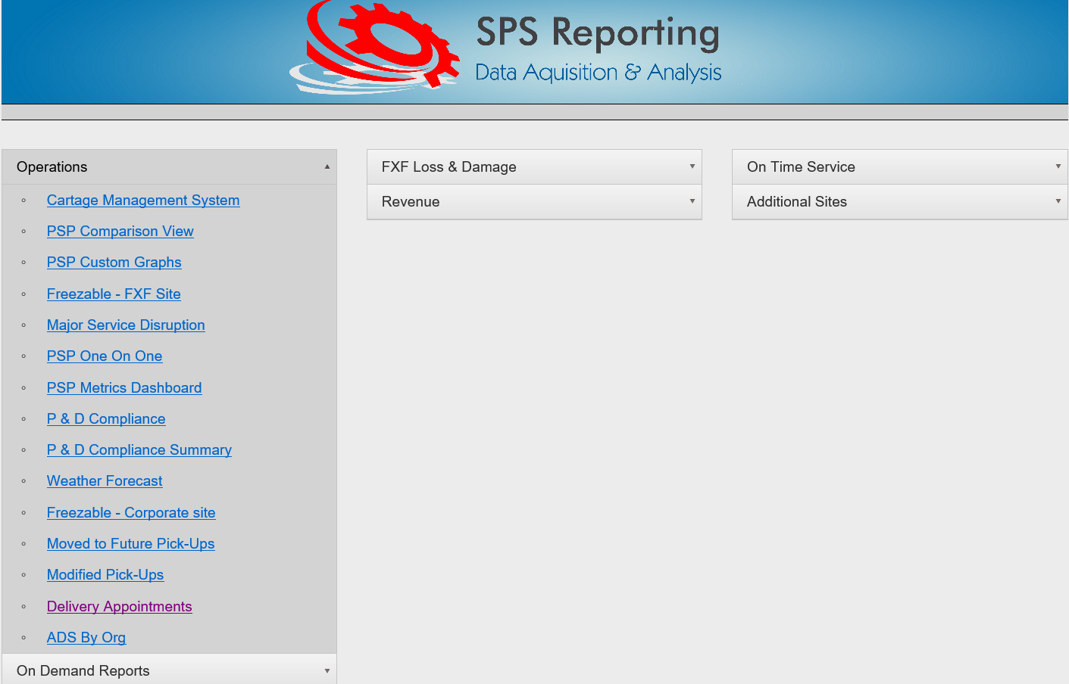
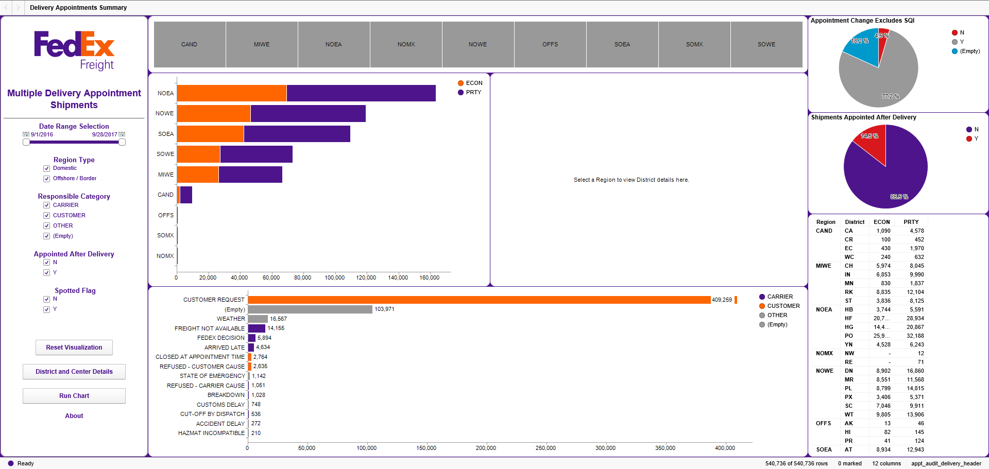
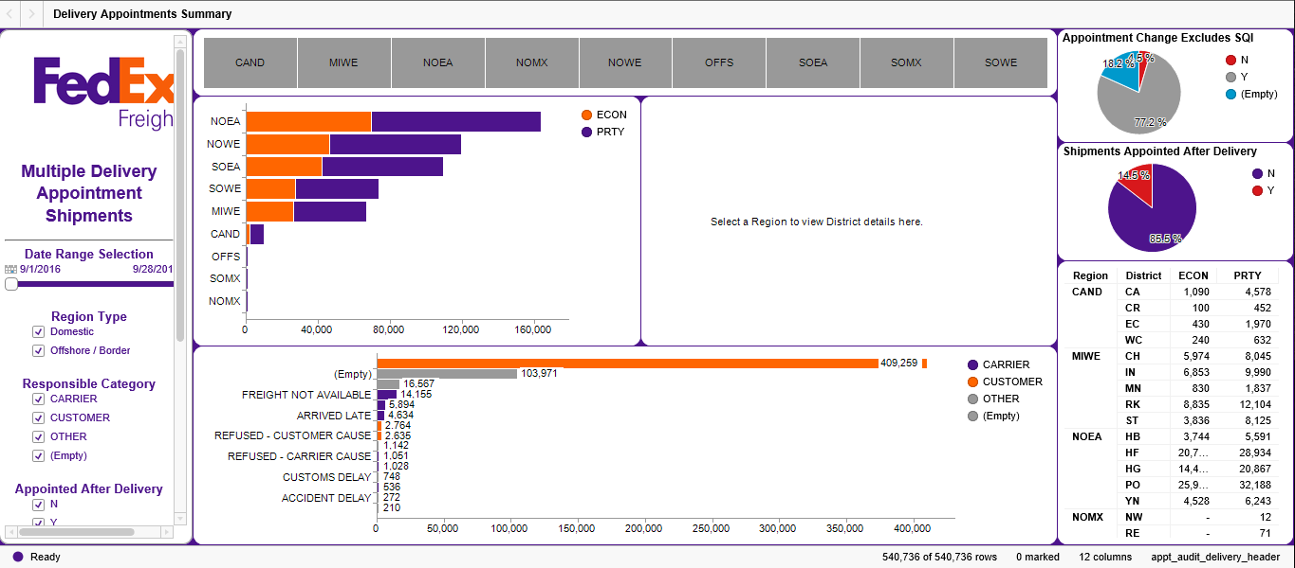
What Does A Spotfire Report Tell Us That Other Reports Cannot?
Delivery Appointments report used for the example
Multiple marking
Tooltips
Scrolling
Navigating pages
Manipulating filters
Resetting data & starting over
LARGE MONITOR
LAPTOP MONITOR

Slide 11
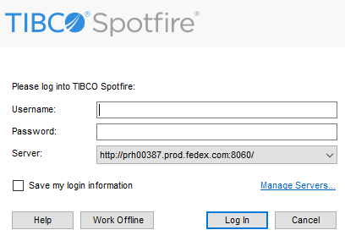


Signing In
In order to work in offline mode, you must connect to the server at least once
Numeric FedEx Employee Number
Spotfire Desktop or Dock Icon
Spotfire Active Analysis Dock Icon
LDAP Password
Please Start Spotfire Now!
DO NOT Click This Box
Click to Work Offline
(Don’t enter username & password)
Click to Work Online
(data accessed on server)

Slide 12
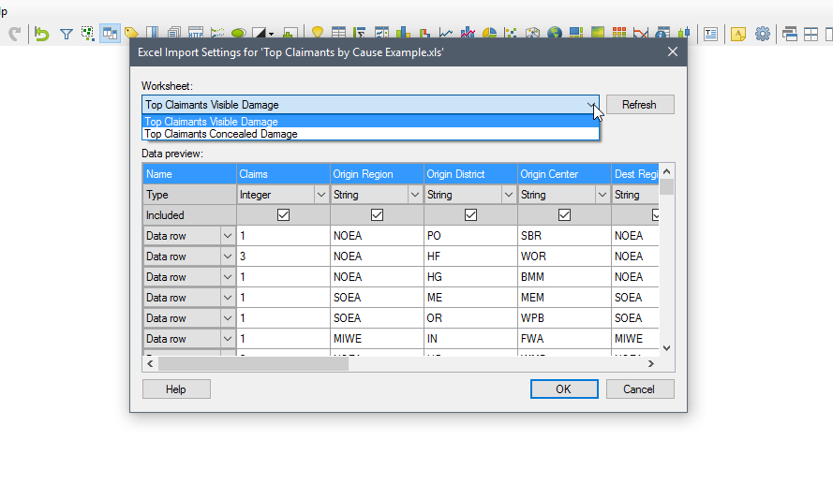
I Have Data – Now What?? Importing your data
Click on this down arrow to show all the available data tabs in your excel sheet

Slide 13
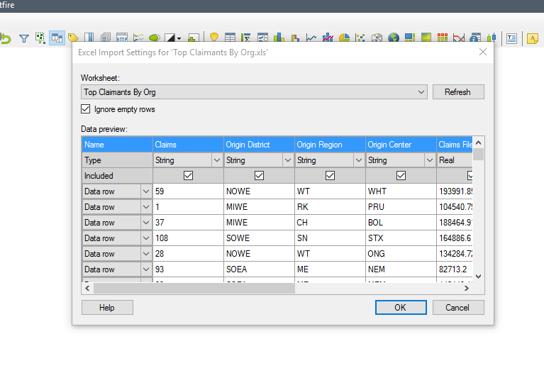
I Have Data – Now What?? Importing your data
Do I need to change any of the column names?
Do I need to change any of the data types?
Do I need to exclude any of the columns or rows?

Slide 14
What Do All those Data Types Mean? Spotfire Icon Glossary
BOOLEAN
True and false. Booleans are used to represent true and false values returned by comparison operators and logical functions.
REAL
Real values are written as standard floating point numbers with a period for a decimal point and no thousands separator.
CURRENCY
The data format behind the currency type is decimal. The decimal data format uses the base 10 in its calculations
SINGLEREAL
SingleReal values are written as standard floating point numbers with lower precision and range than Real.
DATE / DATETIME
A date and time format depending on the locale on your computer. Dates from January 1, 1583 and forward are supported.
STRING
A value represented as text – will not add & total
INTEGER
Integer values are written as a sequence of digits, possibly prefixed by a + or - sign.
TIME
A date and time format depending on the locale on your computer.
LONGINTEGER
LongInteger can be used if the range for the standard Integer is not enough for your needs.
TIMESPAN
TimeSpan is a value describing the difference between two dates.
It has 5 possible fields.

Slide 15
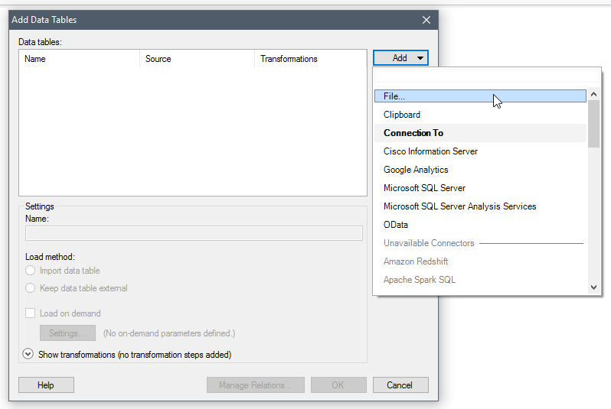
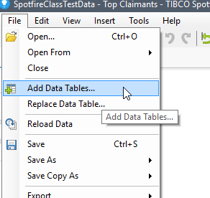
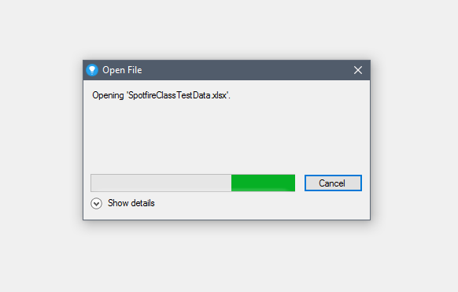
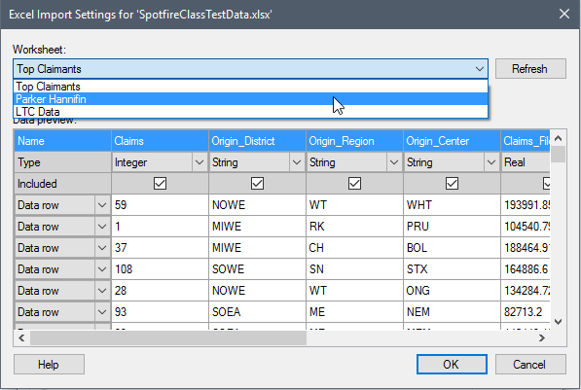
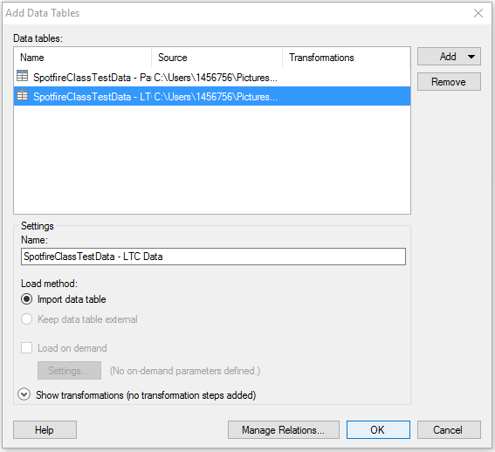
I Have Data – Now What?? Importing your data / Adding data tables
3
2
1
Open SpotfireClassTestData.xlsx
Add Data Tables
Open the same excel file – SpotfireClassTestData.xslx
Add the other 2 worksheets to your existing data

Slide 16
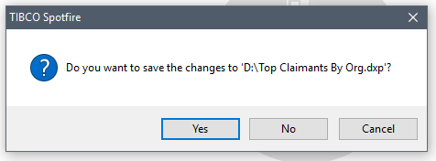
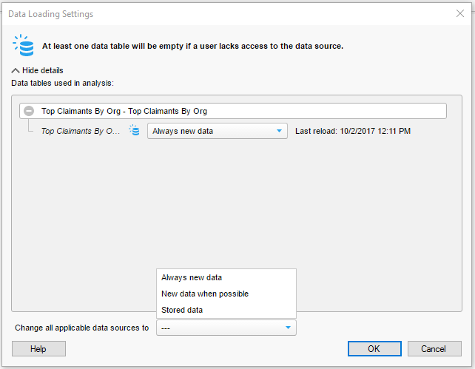
I Have Data – Now What?? Saving Your Work
Always new data
At least one data table will be empty if a user doesn’t have access to the data source
New data when possible
At least one data table will use stored data if a user doesn’t have access to the data source
Stored data
All data is stored in the analysis. No further access to the data sources is needed.

Slide 17
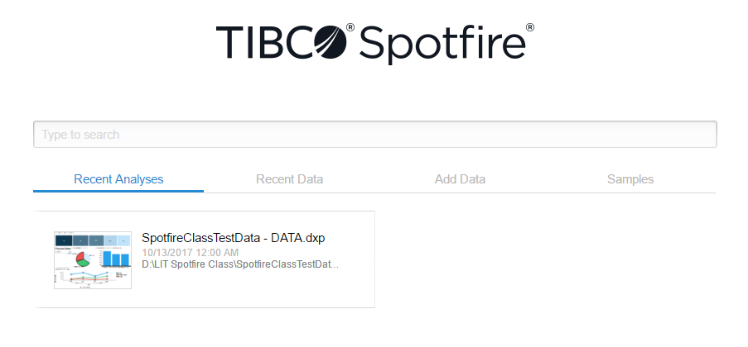
Options From the Home Screen: Recent Analysis

Slide 18
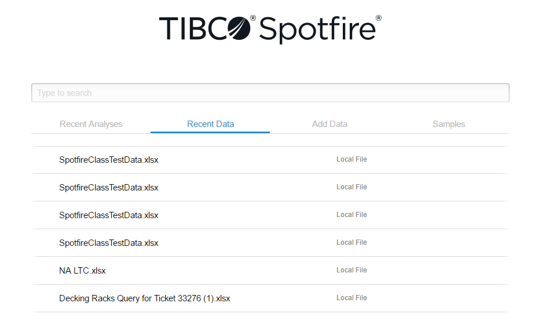
Options From the Home Screen: Recent Data

Slide 19
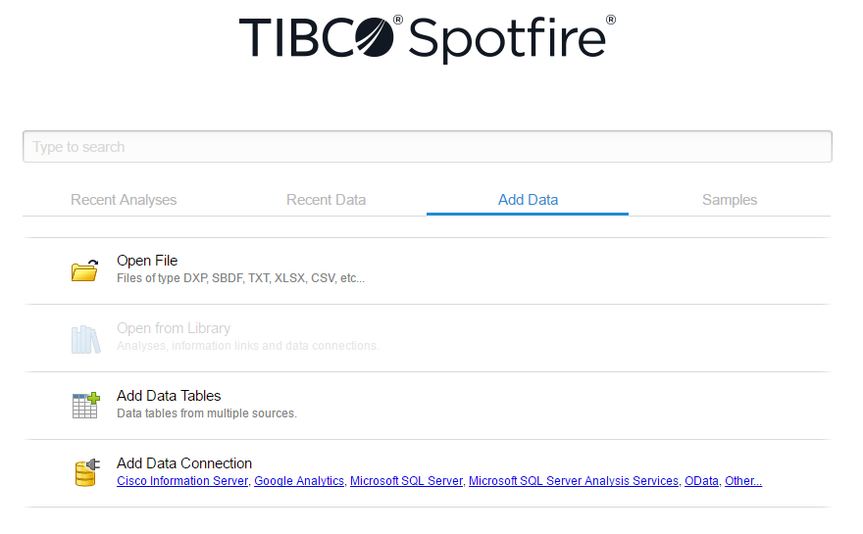
Options From the Home Screen: Add Data

Slide 20
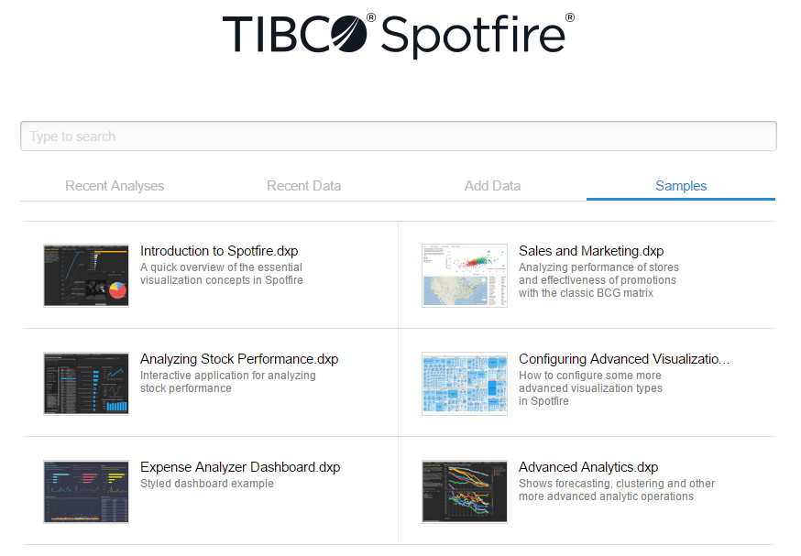
Options From the Home Screen: Samples

Slide 21
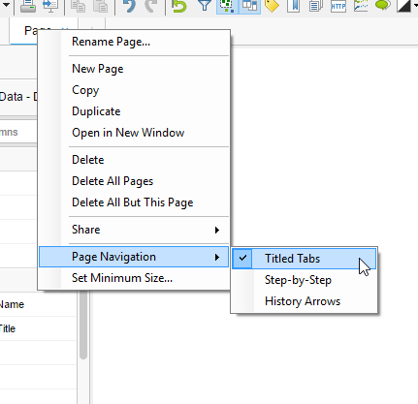
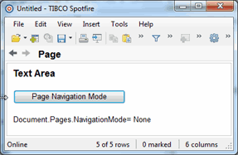
Changing Your Navigation: Titled Tabs, Step-by-Step, History Arrows

Slide 22
What Do All the Icons Mean? Spotfire Icon Glossary
2
4
6
8
10
12
14
16
18
20
22
24
26
28
30
32
34
36
38
40
42
44
46
48
1
3
5
7
9
11
13
15
17
19
21
23
25
27
29
31
33
35
37
39
41
43
45
47
Open new analysis
Add data tables
Reload data
Save
Print
Export to PowerPoint
Copy
Paste
Undo
Redo
Reset all filters
Filters
Details on demand
Data
Tags
Bookmarks
Lists
Web page
Analytic models
Collaboration
Visual theme
New page
Recommended visualizations
Table
Cross table
Graphical table
Bar chart
Waterfall chart
Line chart
Combination chart
Pie chart
Scatter plot
3D scatter plot
Map chart
Treemap
Heat map
KPI chart
Parallel coordinate plot
Summary table
Box plot
Text area
Annotation
Visualization properties
New window
Evenly
Side by side
Stacked
Maximize active

Slide 23
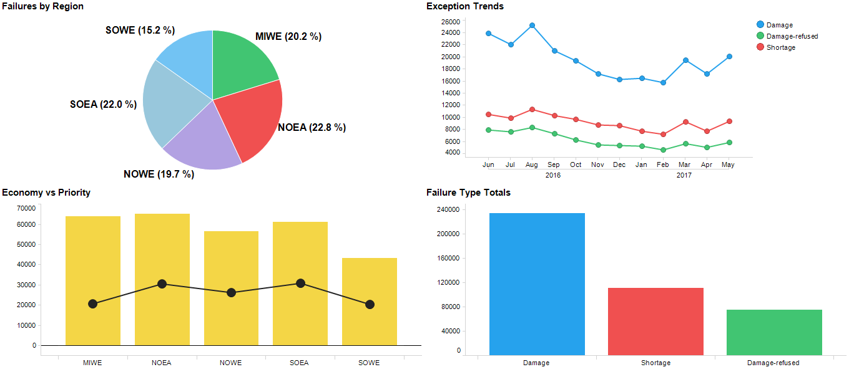
Possible Choices For Your Data

Slide 24
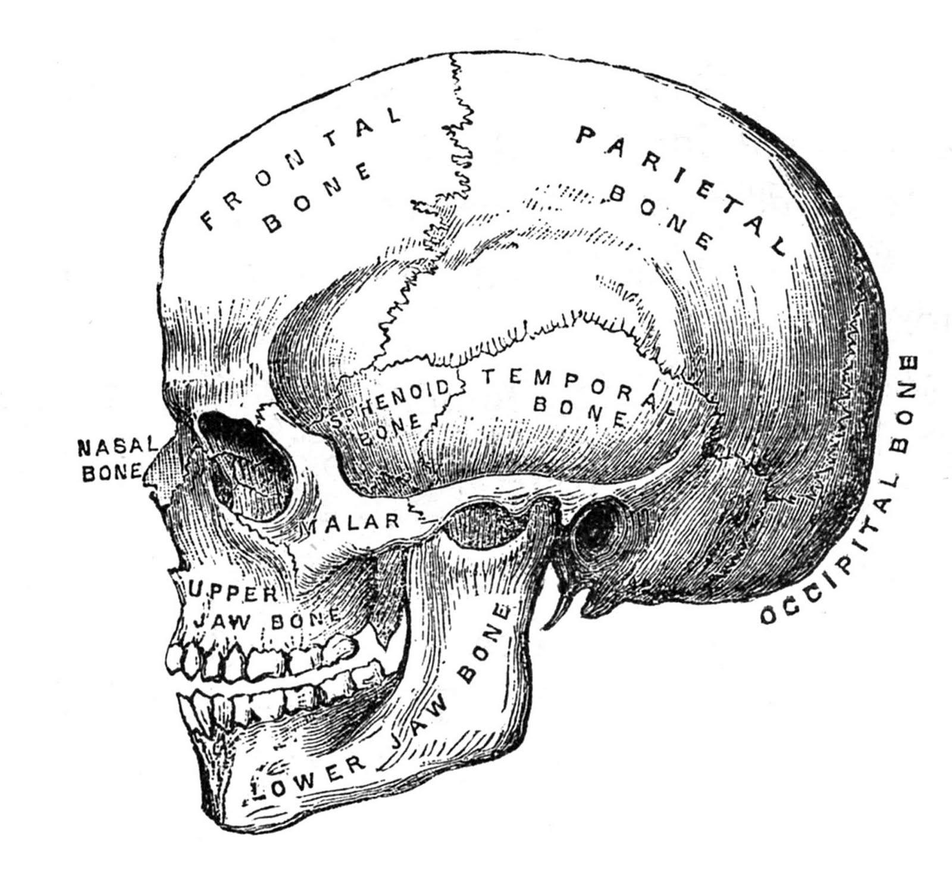
Basic Chart Anatomy: What are the parts?
Title (Hiding the title bar takes away the ability to reposition the visualization)
Distribution – Failure Type
Y Axis
(Value Axis)
X Axis
(Category Axis)

Slide 25
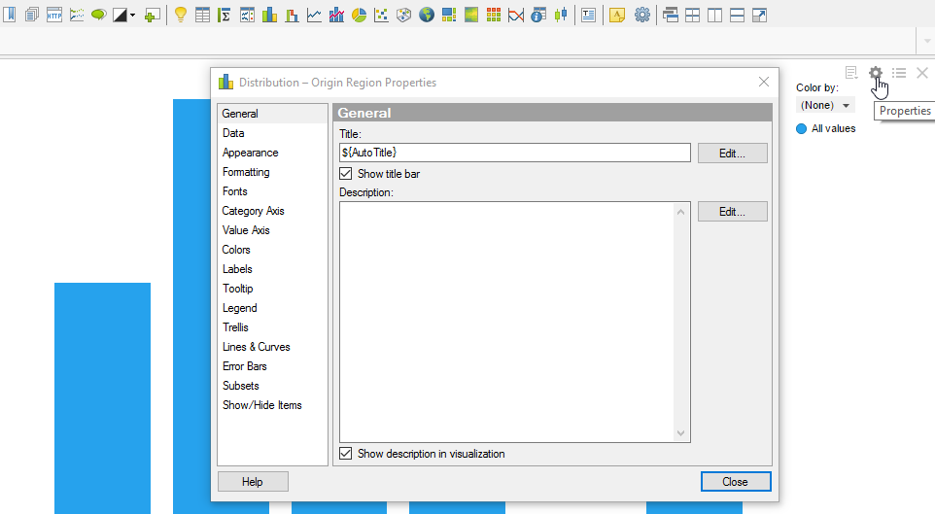
Basic Chart Anatomy: How do I make changes?

Slide 26
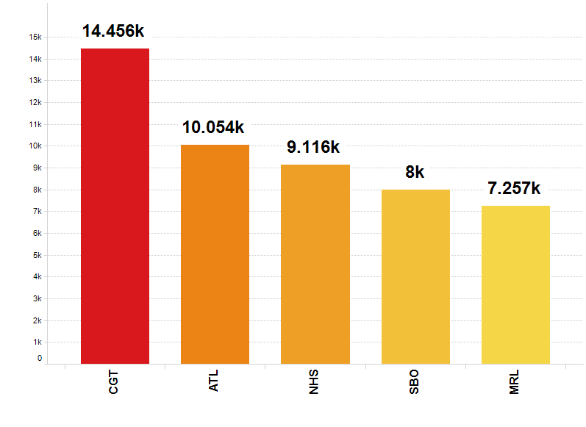
#1 Creating a Bar Chart: Follow Along with the Instructions

Slide 27
Creating a Bar Chart: SpotfireClassTestData / LTC Data Worksheet
Click on the Bar Chart icon (#27 in the Spotfire Icon Glossary)
Category Axis (X) = LTC Service Center
Value Axis (Y) = Failure Type, Aggregation = Count / Display Name = “Exception Totals”
Click on Properties sprocket (appears when you hover over the upper right corner)
In the General section, change the title to “Top 6 LTC Locations”
Click on Show/Hide Items (very bottom selection), Add, Column = Pro Number, aggregation = count
Rule type: Top Value = 6
Colors, Columns = LTC Service Center, aggregation = count
Color mode = Gradient / Max change to red by clicking on the color, change Min to yellow
Double-click in the middle of the color line to add another point & change to orange
Right click in the chart area / click on sort bars by value
Click on Show/Hide Controls (appears when you hover over the upper right corner, farthest choice on the left)
Uncheck Category Axis Selector, uncheck Value Axis Selector, uncheck Legend (can also toggle on and off by clicking the Legend icon – appears when you hover, third from the left)
Click on Properties, Appearance / Slide bar width to 3/4 the size
Click on Formatting / Value Axis, Category, Number, use short number format
Click on Fonts / Category axis scale labels, size = 12 / Value axis scale labels, size = 16, Bold = Yes
Category axis / Scale labels = Vertically
Value axis = Show gridlines
Labels / Show labels for All / Types of labels = Complete bar / Click on Fonts / Bar Chart labels, size = 18, Bold = Yes
Click on Fonts / Bar Chart labels, size = 18, Bold = Yes
Tooltip / Uncheck Category axis, Value axis, color by /Add Column IB/OB/Hub, aggregation = Most Common / change Name to Top Shift, Add LTC Employee Name, aggregation = Most Common, change name to “Top Employee”, click Move Up to change the order
Click on Properties, Data, Limit data using expression, [LTC Employee Name]<>”UNK”

Slide 28
#2 Creating a Line Chart: Follow Along with the Instructions

Slide 29
Creating a Line Chart: SpotfireClassTestData / LTC Data Worksheet
Click on the Line Chart icon (#29 in the Spotfire Icon Glossary)
Category Axis (X) = SQI Date
Value Axis (Y) = Pro Number, Aggregation = Count / Display Name = “Total Failures”
Line by (In upper right corner) = Failure Type
Color by = Failure Type, Aggregation = “(None)”
In the General section, change the title to “Exception Trends FY17”
Edit / Document Properties / Properties / FiscalYearOffset = 5
Click on SQI Date on Y axis, click on right arrow for more options, “Fiscal Year >>Quarter >> Month”
Click on Properties, Appearance, Line Width = 5, Check box for “Show markers” / Slide marker size to make bigger
Remaining in Properties, Lines & Curves, Add “Straight Line Fit”, check box for One Per = Color
Remaining in Properties, Labels, check boxes for “Line Identifier” and “Individual Values”
Remaining in Properties, Formatting, Y:Total Failures, Number, Check box for “Use thousands separator”
Remaining in Properties, Legend, uncheck everything but “Color by”, click on the words “Color by”
Still in Legend, at the bottom – uncheck the boxes for “Show title”, and “Show axis selector”

Slide 30
#3 Creating a Combination Chart: Follow Along with the Instructions

Slide 31
Creating a Combination Chart:
Click on the Combination Chart icon (#30 in the Spotfire Icon Glossary)
Category Axis (X) = Origin District
Click on the Filers icon, under the “Type to search filters” box, click on the arrow and make sure the Top Claimants data is highlighted. Uncheck all boxes except for mainland US regions. Close filters panel.
Value Axis (Y) = Claims Filed Dollars, Aggregation = Avg (Average) / Display Name = “Average Filed”
Value Axis (Y, second axis) = Claims Paid Dollars, Aggregation = Avg (Average) / Display Name = “Average Paid”
Properties, General, Title = “Top 3 Average Filed vs Average Paid”
Remaining in Properties, Show/Hide Items, Add, Column = Claims _Paid_Dollars, Aggregation = Avg (Average), Rule type = Top, Value = 3
Remaining in Properties, Appearance, Line width = 8, use slider to increase marker size
Click on the Average Filed icon under “Series by” in the legend, Show as lines, click on the color wheel at the bottom left, enter “FF6600” in the # entry box to change the color to FedEx orange
Click on the Average Paid icon under “Series by” in the legend, show as bars, click on the color wheel at the bottom left, enter “4D148C” in the # entry box to change the color to FedEx purple
Properties, Labels, Show labels for = All, uncheck “Show bar labels”, check “Show line marker labels”
Remaining in Properties, Fonts, Labels, Size = 20, Bold = Yes
Click on “Show/Hide Controls” (appears when you hover over the upper right corner, uncheck everything but “Title Bar”, “Legend”, and “Scale Labels”
Properties, Legend, uncheck everything but “Series by”, click on the words “Series by”, uncheck “Show title”, and ‘Show axis selector”
SpotfireClassTestData / Top Claimants Worksheet

Slide 32
#4 Creating a Pie Chart: Follow Along with the Instructions

Slide 33
Creating a Pie Chart:
Click on the Pie Chart icon (#31 in the Spotfire Icon Glossary)
Properties, General, Title = “Damage vs Shortage”
Mark (select) the sections that represent Damage (light blue) & Damage-refused (green)
Right-click, Group from Marked Categories, rename to “All Damage”
Color by = Failure Type, click on the yellow dot next to “All Damage”, and change to FedEx purple = “4D148C”.
Color by = Failure Type, click on the red dot next to “Shortage”, and change to FedEx orange = “FF6600”.
Properties, Labels, Check box for “Sector category”, label position = Inside pie, show labels for All
Remaining in Properties, size, make pie size as large as it gets
SpotfireClassTestData / Top Claimants Worksheet

Slide 34
#5 Creating a Treemap: Follow Along with the Instructions

Slide 35
Creating a Treemap:
Click on the Treemap icon (#35 in the Spotfire Icon Glossary)
In the Legend, Data table: SpotfireClassTestData – Parker Hannifin
Color by Pro, Aggregation = Count
Size by Pro, Aggregation = Count
Hierarchy = DEST
Properties, Colors, Color mode = Gradient, change Max to FedEx orange, Red = 255, Green = 102, Blue = 0
Remaining in Colors, change Min to light blue
Remaining in Properties, Tooltip, uncheck all boxes
Column CONSIGNEE NAME, Aggregation = Most Common, Name = “Top Consignee”
Column PRO, Aggregation = Count, Name = “Total Exceptions”
Properties, General, Title = “Total Exceptions by DEST”
Click on Legend (appears in upper right corner) to toggle the legend off
SpotfireClassTestData / Parker Hannifin Worksheet

Slide 36
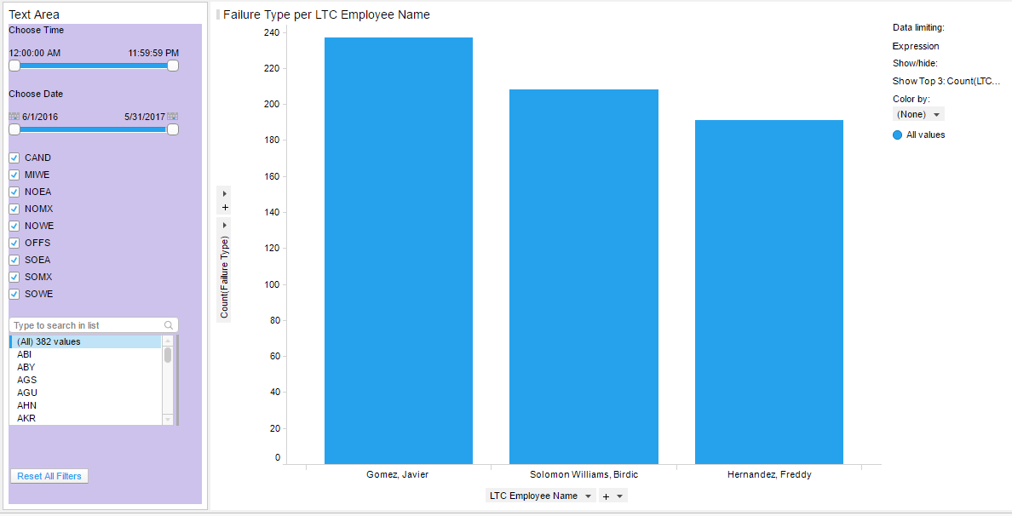
#7 Creating a Text Area: Follow Along with the Instructions

Slide 37
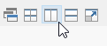
Creating a Text Area:
Click on the Text Area icon (#41 in the Spotfire Icon Glossary)
Click on the Bar Chart icon to also bring in a bar chart
Click on the Side-by-Side icon on the far right of the icons across the top
Type “Choose Time”, press enter
Click on Insert Filter icon (looks like a funnel) - Filtering scheme = Text Area, LTC Time, press enter
Type “Choose Date”, press enter
Click on Insert Filter, SQI Date, press enter, click on the save icon and your items will appear in the text area. Nothing will record in the text area until you hit save.
Insert Filter, LTC Region, hit enter
Insert Filter, LTC District, hit enter
Click on background color (looks like a paint can), change background color to light purple
On bar chart, X axis = LTC Employee Name / Y axis = Pro Number, Aggregation = Count
Properties, Show/Hide Items, Add, Value = 3
Size the text area so it fits with the visualization
SpotfireClassTestData / LTC Data Worksheet

Slide 38
#8 Creating a Table: Follow Along with the Instructions

Slide 39
Creating a Table:
Click on the Table icon (#24 in the Spotfire Icon Glossary)
Click on the “Pro Number” column heading, click on the first arrow to sort ascending
Hold your cursor between 2 column headings so it forms a double arrow. Right-click with your mouse, and click on “Resize Columns to Fit” to change the width of each column to fit the data in that column.
With your cursor between 2 column headings so it forms a double arrow, hold down the ctrl button and drag the red line left or right. When you release the mouse button, all columns will snap to that new width
Properties, General, Title = “Opportunities”
Remaining in Properties, Appearance, Check “Show Cell Borders”, Number of frozen columns = 1 (now it freezes the first column as you scroll)
Grab the Delivery Date column and drag it just to the right of the SQI Date column
Properties, Columns, SQI Year, Remove
Click on a cell about 1/3 of the way down and drag over several rows. Marked rows will turn green.
SpotfireClassTestData / LTC Data Worksheet

Slide 40
#9 Creating a Summary Table: Follow Along with the Instructions

Slide 41
Creating a Summary Table:
Click on the Summary Table icon (#39 in the Spotfire Icon Glossary)
Properties, General, Title = Claims Information
Remaining in Properties, Columns, Categorization = Origin Region
Remaining in Properties, Sorting, Sort by Sum, choose Descending
Click on Legend (appears in the upper right when you hover over it) to toggle it off
SpotfireClassTestData / Top Claimants Worksheet

Slide 42
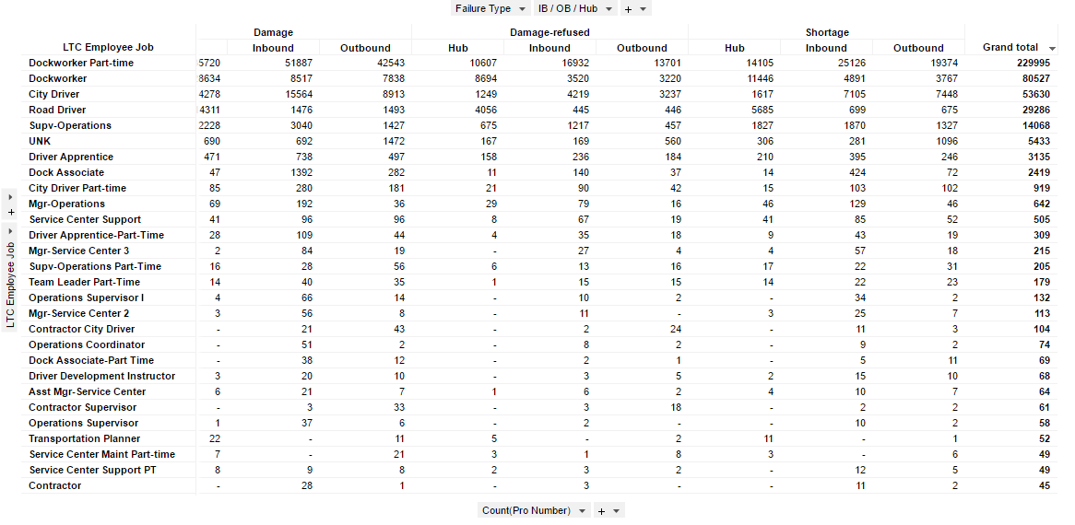
#10 Creating a Cross Table: Follow Along with the Instructions

Slide 43
Creating a Cross Table:
Click on the Cross Table icon (#25 in the Spotfire Icon Glossary)
Properties, Axes, Horizontal = Failure Type + IB/OB/Hub / Vertical = LTC Employee Job / Cell Values = Pro Number, Aggregation = Count
Right-click in the visualization, click on “Grand Total for Columns”
Click at the top of the Grand total column, sort by descending
SpotfireClassTestData / Top Claimants Worksheet

Slide 44
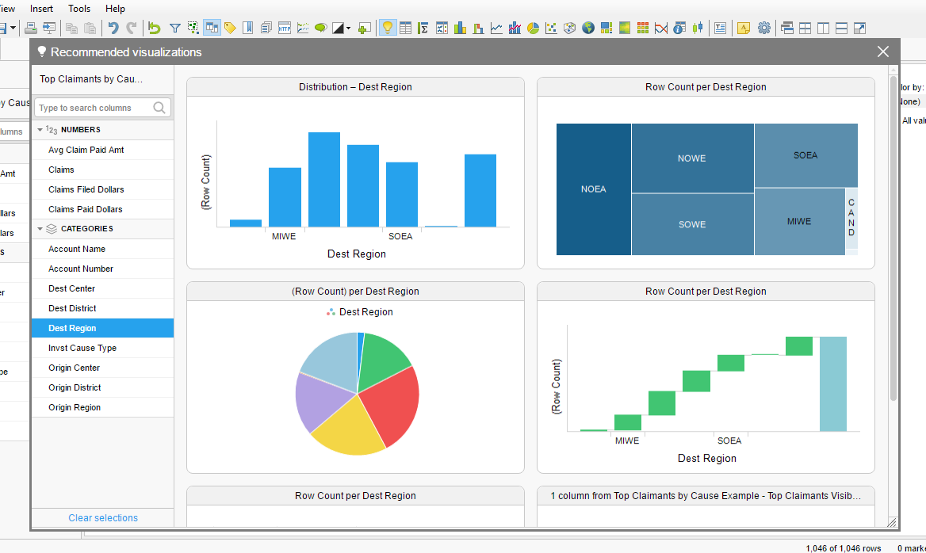

Getting a Fast Start with Recommended Visualizations

Slide 45
Itinerary - Day 2
Brief Basic Spotfire Review from Day 1
What’s In All Those Tabs?
Configuring Interactivity – Walkthrough With Instructors
Filtering Data Before It Reaches The Report / Creating Filtering Schemes
Marking (test data) / Marking as in Selecting / Marking as in Data Limiting (create simple bar chart)
Creating Markings Through Document Properties / How Markings Work To Differentiate Data
Different Colors For Markings / Different Names For Markings / Creating A Hierarchy
Multiple Marking By Dragging Across Multiple Items / CTRL + Select
Details Visualizations / Details On Demand Options (Using Table vs DOD Icon)
Limit Data Using Filters / Limit Data Using Expressions
Creating a dashboard to tie it all together
LUNCH – 12:30PM
Activity #1 – Create a 3-Tier hierarchy with bar charts allowing you to drill down from Regions to Districts to Centers
Activity #2 – Create a treemap that shows the top 10 documenting locations sized & colored by totals, a text filter that distinguishes between failure types & allows you to pick dates. Add 2 more interactive visualizations that make sense.
Configuring Interactivity – Dashboard Scenario Activity, use a tree map, text area date selector, pie chart, bar graph, line chart histogram, details on demand
#1 Who are the top 3 LTC employees by shift for each district in your region?
#2 Show the results for Q3 & Q4 + the trends
Cover all available help, Cover Spotfire Demo File
Use your own data or use ours to create a dashboard / Additional Help time
Helpful Tips:
To avoid having to take this class again…
Please take lots of notes!
Please ask questions if you feel lost
Please do not try to think ahead
Please BE HERE NOW

Slide 46
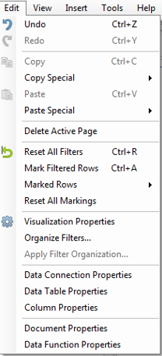
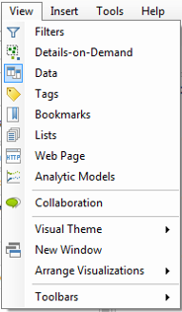
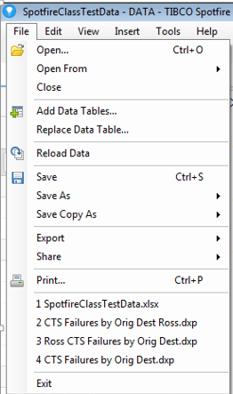
What’s in All Those Tabs? Spotfire Menu Glossary 1

Slide 47
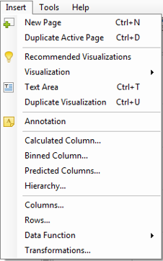
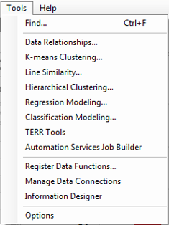
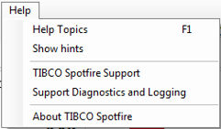
What’s in All Those Tabs? Spotfire Menu Glossary 2

Slide 48
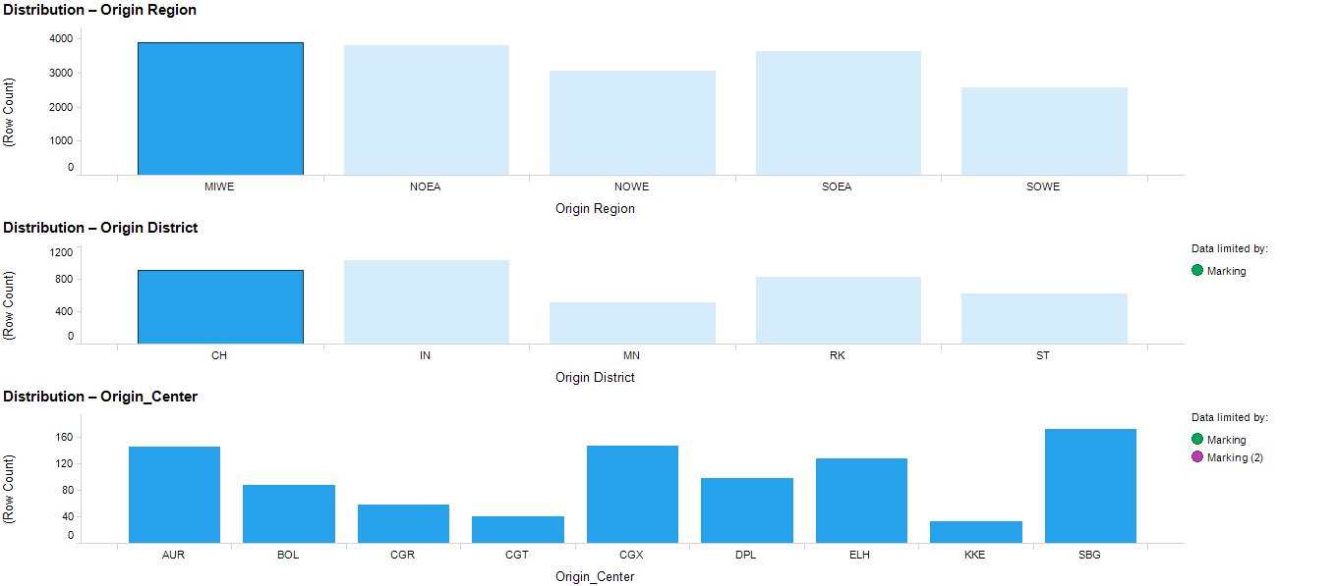
Activity #1 - Create a 3-Tier hierarchy with bar charts allowing you to drill down from Regions to Districts to Centers
Filter Settings
- Origin Region: (MIWE, NOEA, NOWE, SOEA, SOWE)

Slide 49
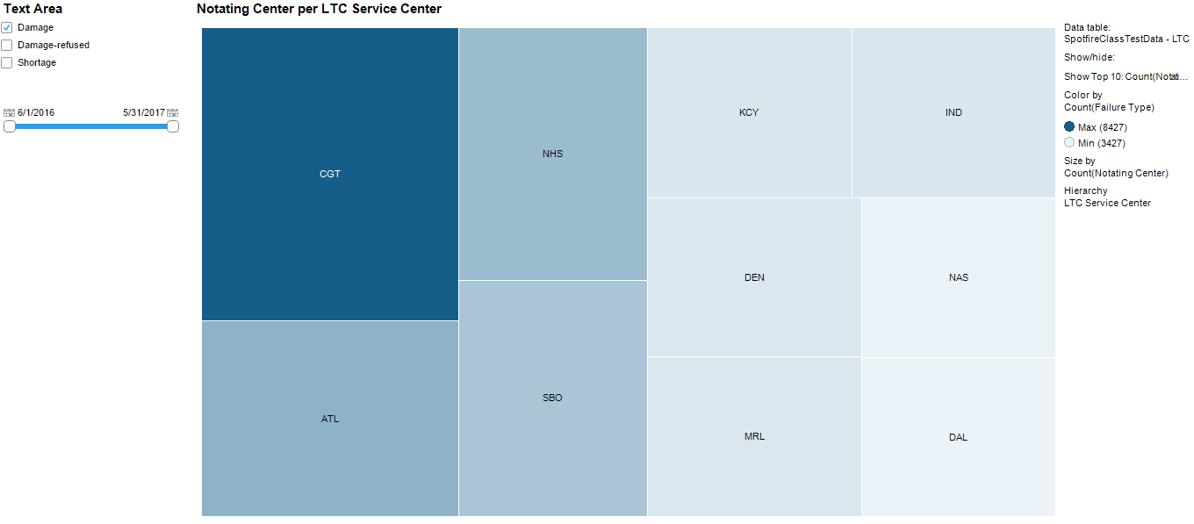
Activity #2 - Create a treemap that shows the top 10 documenting locations sized & colored by totals, a text filter that distinguishes between failure types & allows you to pick dates. Add 2 more interactive visualizations that make sense.

Slide 50
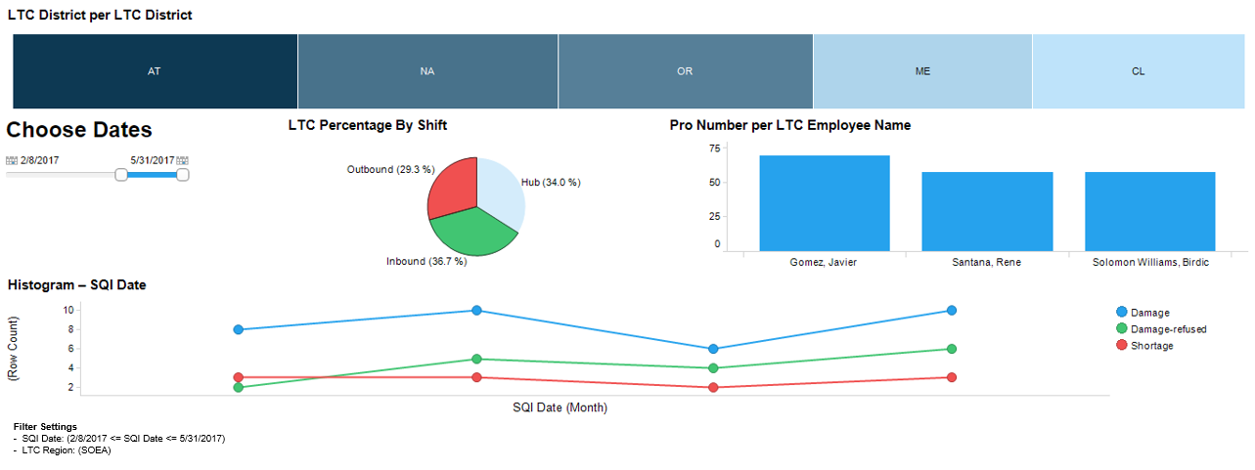
Configuring Interactivity – Making it all work together

Slide 51
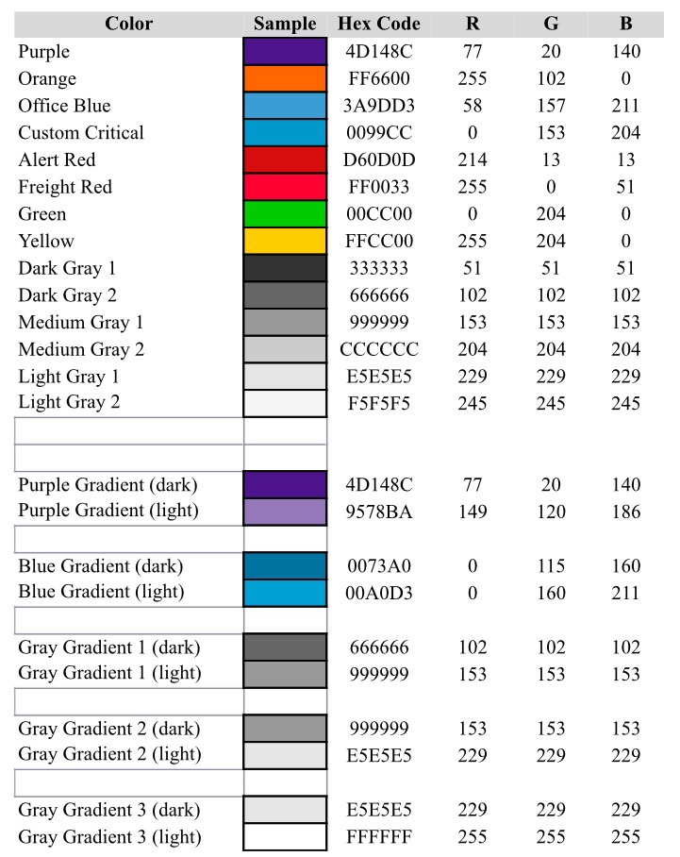
Tibco Software Consumer User’s Guide Links
Creating a Bar Chart
Creating a Line Chart
Creating a Combination Chart
Creating a Pie Chart
Creating a Tree Map
Creating a Table
How to Use A Summary Table
Creating a Cross Table
Calculated Columns
Marking
Spotfire Learn
Fiscal Year Offset = 5
(Edit-Document Properties-Properties-Fiscal Year Offset-Edit-Value = 5)

Slide 52
Itinerary - Day 3
Spotfire Review from Days 1 & 2
Any Questions???
Using Spotfire with Realistic Scenarios:
The SCM for SWA has received calls from 3 different customers complaining they have seen a spike in exceptions on their OB freight since July (we are living in 2016). He comes to you and asks you to point out top OB opportunities for the center as a whole.
The NAS SCM tells you their LTC is getting out of control. Can you provide the top 5 LTC employees for each shift & point out some opportunities?
We are about to lose Parker Hannifin due to high exceptions. Your MD needs a couple of slides for an RVP presentation tomorrow.
Class-suggested scenarios, time permitting
Reconvene on a call in 2 weeks, project requirements
CLASS DISMISSED!!!
Helpful Tips:
To avoid having to take this class again…
Please take lots of notes!
Please ask questions if you feel lost
Please do not try to think ahead
Please BE HERE NOW

